Slide 1
Collection of Data

Slide 2
Steps Involved
Step 1 : Placement of the Emotive Epoch+ EEG Headset on the head of the patient
Step 2 : Placement of electrodes to the face of the patient ( to measure EOG )
Step 3 : Attachment of the electrodes to the Holter .
Step 4 : Attaching the Samsung Gear G2 ( PPG Watch ) for PPG signal measurement.
Step 5 : Measuring data

Slide 3
Placement of the EEG measuring device ( Emotive Epoch+)
Before using the Emotive Epoch+ headset , the headset is charged to its maximum capacity .
Once charged , the EEG device is placed on the head of the patient.
The electrodes of the EEG device are moved and positioned in such a way that the contact between the surface of the head ( scalp ) and the electrode is maximum .
For this , it is recommended that the patient to have a hair cut before taking the measurement . Results prove accurate with minimum hair in the head.
Now , attach the Emotive Epoch+ Bluetooth Dongle with the PC.
Now configure the Emotive Epoch+ software and you can see the contact quality of the electrodes with the head.
_______________________________________________________________________________
Do not keep the headset ON while charging as it may damage the headset . Also , only charge the Emotive Epoch+ headset through the USB charger provided . Do NOT use a USB charger .

Slide 4
Placement of the EEG measuring device ( Emotive Epoch+)
To improve contact either pour saline solution on the electrodes ( which has proved much efficient ) or move the hair of the patient to establish good contact.
Ask the patient not to move his/her head too much as it may affect the EEG signal transferred to the PC. Also the patient should not change their sitting position too much for the same reason mentioned above .
It is advisable to use a USB extender and then attach the Emotive Epoch+ USB Dongle to it and place it near the Emotive Epoch+ Headset so that the connectivity between the Headset and the Dongle is maximum .
Press the Record button on the Emotive Epoch+ software to start recording the signal .

Slide 5
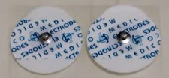
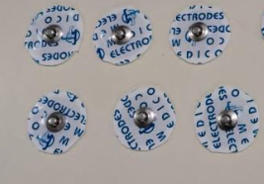
Placement of Electrodes on the patient’s face
The electrodes used in this experiment have a metallic contact to attach the holter’s terminals to it ( the electrodes ) on one side and a silicon chip surrounded by conductive silica gel .
When placed on the skin of the patient , the gel expands and sticks with the skin.
The electrodes have to be cut in order to have minimum diameter so that it would be easy to place it near the eyes for EOG signal measurement .
Uncut Electrodes
Cut Electrodes

Slide 6
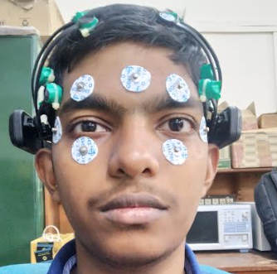
Placement of Electrodes on the patient’s face
The Holter is a device which acquires the data from the electrodes and feeds it into the computer for monitoring purposes.
The Holter consists of three channels with differential mode input and a neutral wire for reference .
The placement of the electrodes on the face of the patient is as shown in the image.
Placement of Electrode on Patient’s Face :
( From patient’s perspective )
Channel I : + ve terminal placed above Right Eye
- ve terminal placed below Right Eye
Channel II: + ve terminal placed above Left Eye
- ve terminal placed below Left Eye
Channel III : + ve terminal placed to the right end of the Right Eye
- ve terminal placed to the left end of the Left Eye

Slide 7
Attachment of electrodes to the Holter
Usually , Holter is used for measuring EGC signals . However , it can be also used to measure EOG signals too.
The Holter transfers the data measured by the electrodes to the data acquisition system ( DAS ) and then transfers it to the computer .
The Holter used in this measurement uses a 3-channel differential mode input ( which improves noise immunity of the input signal ).
The terminals of the Holter are then connected to the Silica Gel electrodes attached to the face of the patient.
The electrodes should be attached firm . It is advisable that the patient himself attaches the electrodes tot his face .

Slide 8
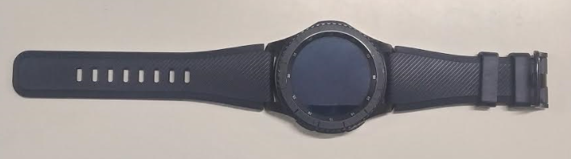
Attachment of the PPG measuring device
PPG is known as Photo Plethysmo Gram.
It is used to log the user data into the computer for analytical purposes.
The Samsung G2 smart watch is used here to collect the data from the patient . The patient is told to perform some activity ( such as playing a video game ) and the watch monitors it .

Slide 9
Experimental Environment
The experimental environment makes use of three monitors to display the EEG and the EOG signals on the screen , two PCs to acquired the data from the measuring device , one web camera to capture a video of the patient’s activity during the experiment
The experimental environment and the equipment used are shown in the following slide.

Slide 10
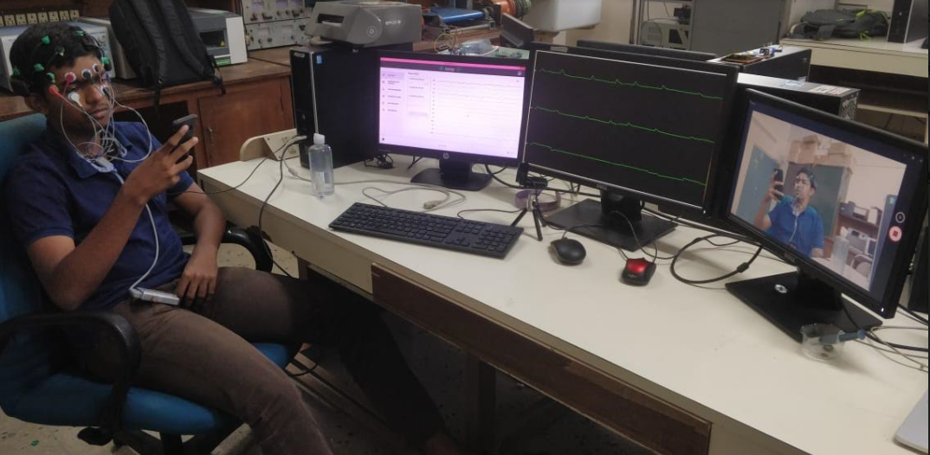
Experimental Environment

Slide 11
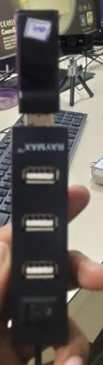
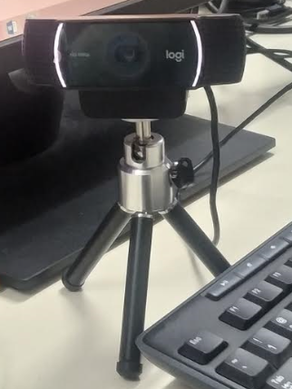
Bluetooth Dongle
Wireless Bluetooth Dongle
Video Recording Camera

Slide 12
Starting the Experiment
The experiment is started once everything is prepared .
The Emotive Epoch+ Headset , the Holter , the Video Recorder , the PPG measuring device ( Samsung Smart G2 watch ) and the activity should be started at the same time so that the data collected from the various devices have some sort of correlation .
Synchronization of the data acquired from the various devices is the most difficult tasks to do in data collection.

Slide 13
During the Experiment
The patient should maintain patience as much as possible . Any sudden movements during the experiment may cause disturbance in the measurement process .
The functioning of the device(s) ( both Emotive and Holter ) should be monitored and any error occurring in them should be rectifier as soon as possible .

Slide 14
Commencing of the experiment & Storage of signal data
Once the set time is elapsed , all devices should be synchronously be turned off so no extra data may be acquired from the measuring devices.
The data should be stored from the measuring devices / data acquisition devices carefully in a location.

